Slide 1

Parking

Slide 2

Different rules for different parkers
Owners and occupiers
Visitors
Third parties

Slide 3
Owners and occupiers
Owners and occupiers are subject to the by-laws.
As the BCCMA provides for:
  The ability to regulate the use of common property through the by-laws (where parking on the common property falls under this umbrella); and
  A prescribed by-law enforcement procedure,
  parking issues for owners and occupiers is primarily a by-law enforcement issue.

Slide 4
By-law enforcement
Need to ensure the proper by-law is in place – i.e. owners and occupiers cannot park on common property without committee approval
Enforcement steps:
  Warning letter
  Contravention notice
  Conciliation application
  Adjudication application
  Enforcement of order
Towing is not by-law enforcement

Slide 5
Visitors
By-laws cannot be enforced against visitors
Who is a visitor?
  Sailz Whitsunday [2009] QBCCMCmr 305
  A bona fide visitor is someone who is not the owner or occupier, however temporary that occupation may be. If holiday-makers are renting units, they are treated as “occupiers” and must use the unit’s exclusive use area carport. A visitor is someone who calls on the owner or occupier. The length of time over which a visitor needs to stay may vary depending on the purpose of the visit.
Why is visitor parking so important? Council says so:
  Palm Pacifique [2017] QBCCMCmr 300:
  It is generally a local authority requirement that a scheme carries a certain number of visitor car parking spaces, and if this is the case, it is not within the power of the committee or body corporate to allow usage by anyone other than bona fide visitors.

Slide 6
Visitor parks – can you restrict time
It depends…
Sailz Whitsunday [2009] QBCCMCmr 305:
Unless specifically stated, I am of the view that visitor car parking must be freely accessible to visitors with no encumbrances, and be free of charge, and that access and egress must not be restricted by keys or barriers in any way tending to privatise the space, or reserve the space for another. It follows that a restriction on times of use flies in the face of the purpose of the “visitor car park” since bona fide visitors may stay overnight…
Charlotte Towers [2008] QBCCMCmr 357:
Clearly, certain car spaces are designated as visitor car spaces in accordance with the development approval, and the purpose and intention of the by-law is to ensure the equitable allocation of visitors’ car parking spaces. This is achieved by implementation of a system whereby a visitor’s vehicle may not remain in a visitor’s car parking space for longer than 8 hours in any 24 hour period. A challenge to a similar by-law was rejected by an adjudicator in Admiralty Towers [641 of 2000] who suggested that such a by-law was necessary to ensure an equitable allocation spaces of visitors’ car parking spaces rather than to allow the visitor car parks to be occupied on a “first in first served” basis. A similar opinion was expressed by the adjudicator in Villa Estoril [089 of 2004].
Principle is to protect visitor parking - time restrictions cannot be imposed unless there are specific circumstances that are required to allow the visitor car parks to be used for visitors.

Slide 7
Third parties
Basically trespassers
Don’t have a right to be at the scheme – might be close to the beach or close to public transport
This is when towing may be relevant if you:
  Comply with towing legislation (which essentially requires consent of the third party – usually impliedly obtained through signage); and
  Comply with body corporate legislation (which is why you cannot tow owners and occupiers – and needs a reasonable decision to be made).
Issue is identifying whether the car is parked by a third party, visitor or owner or occupier. Some service providers are creating software platforms to assist with this

Slide 8
Fines
Owners and occupiers - by-laws cannot impose a monetary liability and cannot be enforced against anyone other than owners and occupiers
Development approval condition will require visitors to have unimpeded access to visitor parking
No power to “fine” third parties but (if DA conditions allow) there can be some arrangements where spare parks are “licenced” but cannot carry on a business
Short version is – no.

Slide 9
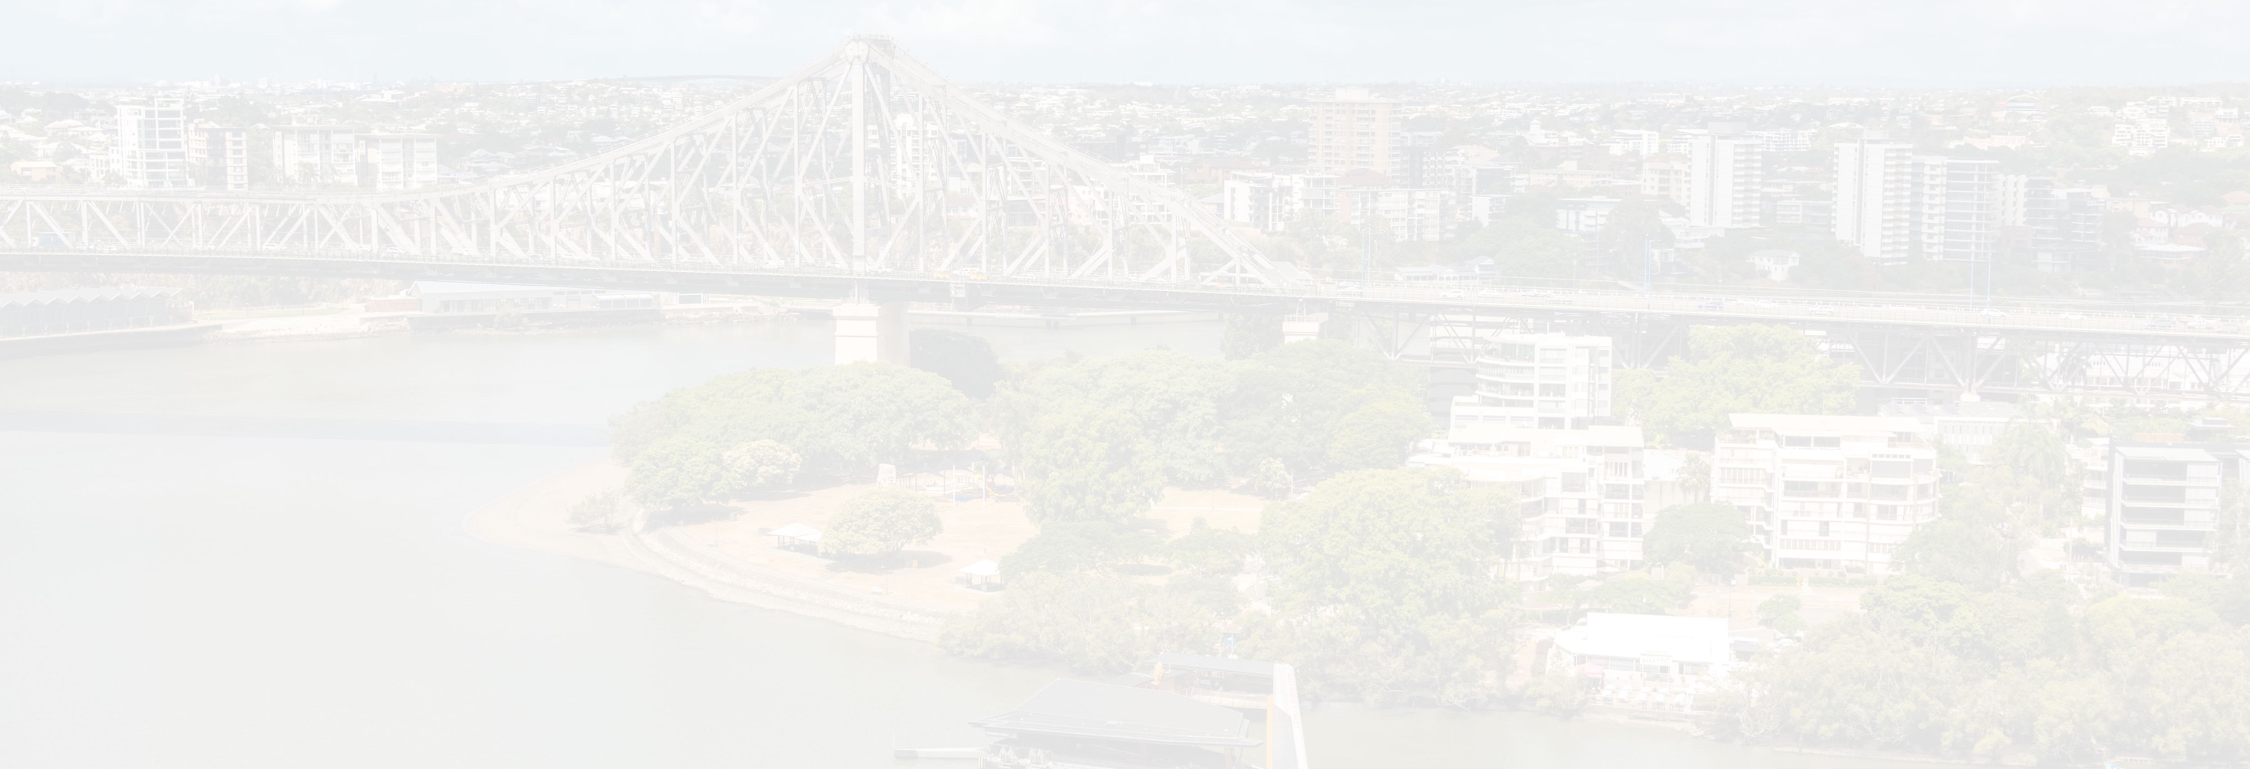
Client focused. Access commercial legal services from Mahoneys' experienced team.
BRISBANE
P: +61 7 3007 3777
F: +61 7 3007 3778
E: info@mahoneys.com.au
A: Level 18, 167 Eagle Street
GPO Box 3311, Brisbane 4001
QLD Australia
Gold coast
P: +61 7 5562 2959
F: +61 7 5575 7803
E: info@mahoneys.com.au
A: Level 2, 235 Varsity Parade
PO Box 482, Varsity Lakes 4227
QLD Australia
Liability limited by a scheme approved under Professional Standards Legislation
www.mahoneys.com.au

