Slide 1
CONTAMINANTS
Asbestos,
Mould
& Illicit Drugs

Slide 2

Overview
Asbestos
What is ACM?
(Asbestos Containing Material)
Where do we find ACM?
(Asbestos Containing Material)
What are the risks of Abestos?
Friable/unbonded
Non friable/bonded
In products
In buildings including Strata
Health risks
Damage and/or repairs
in buildings

Slide 3
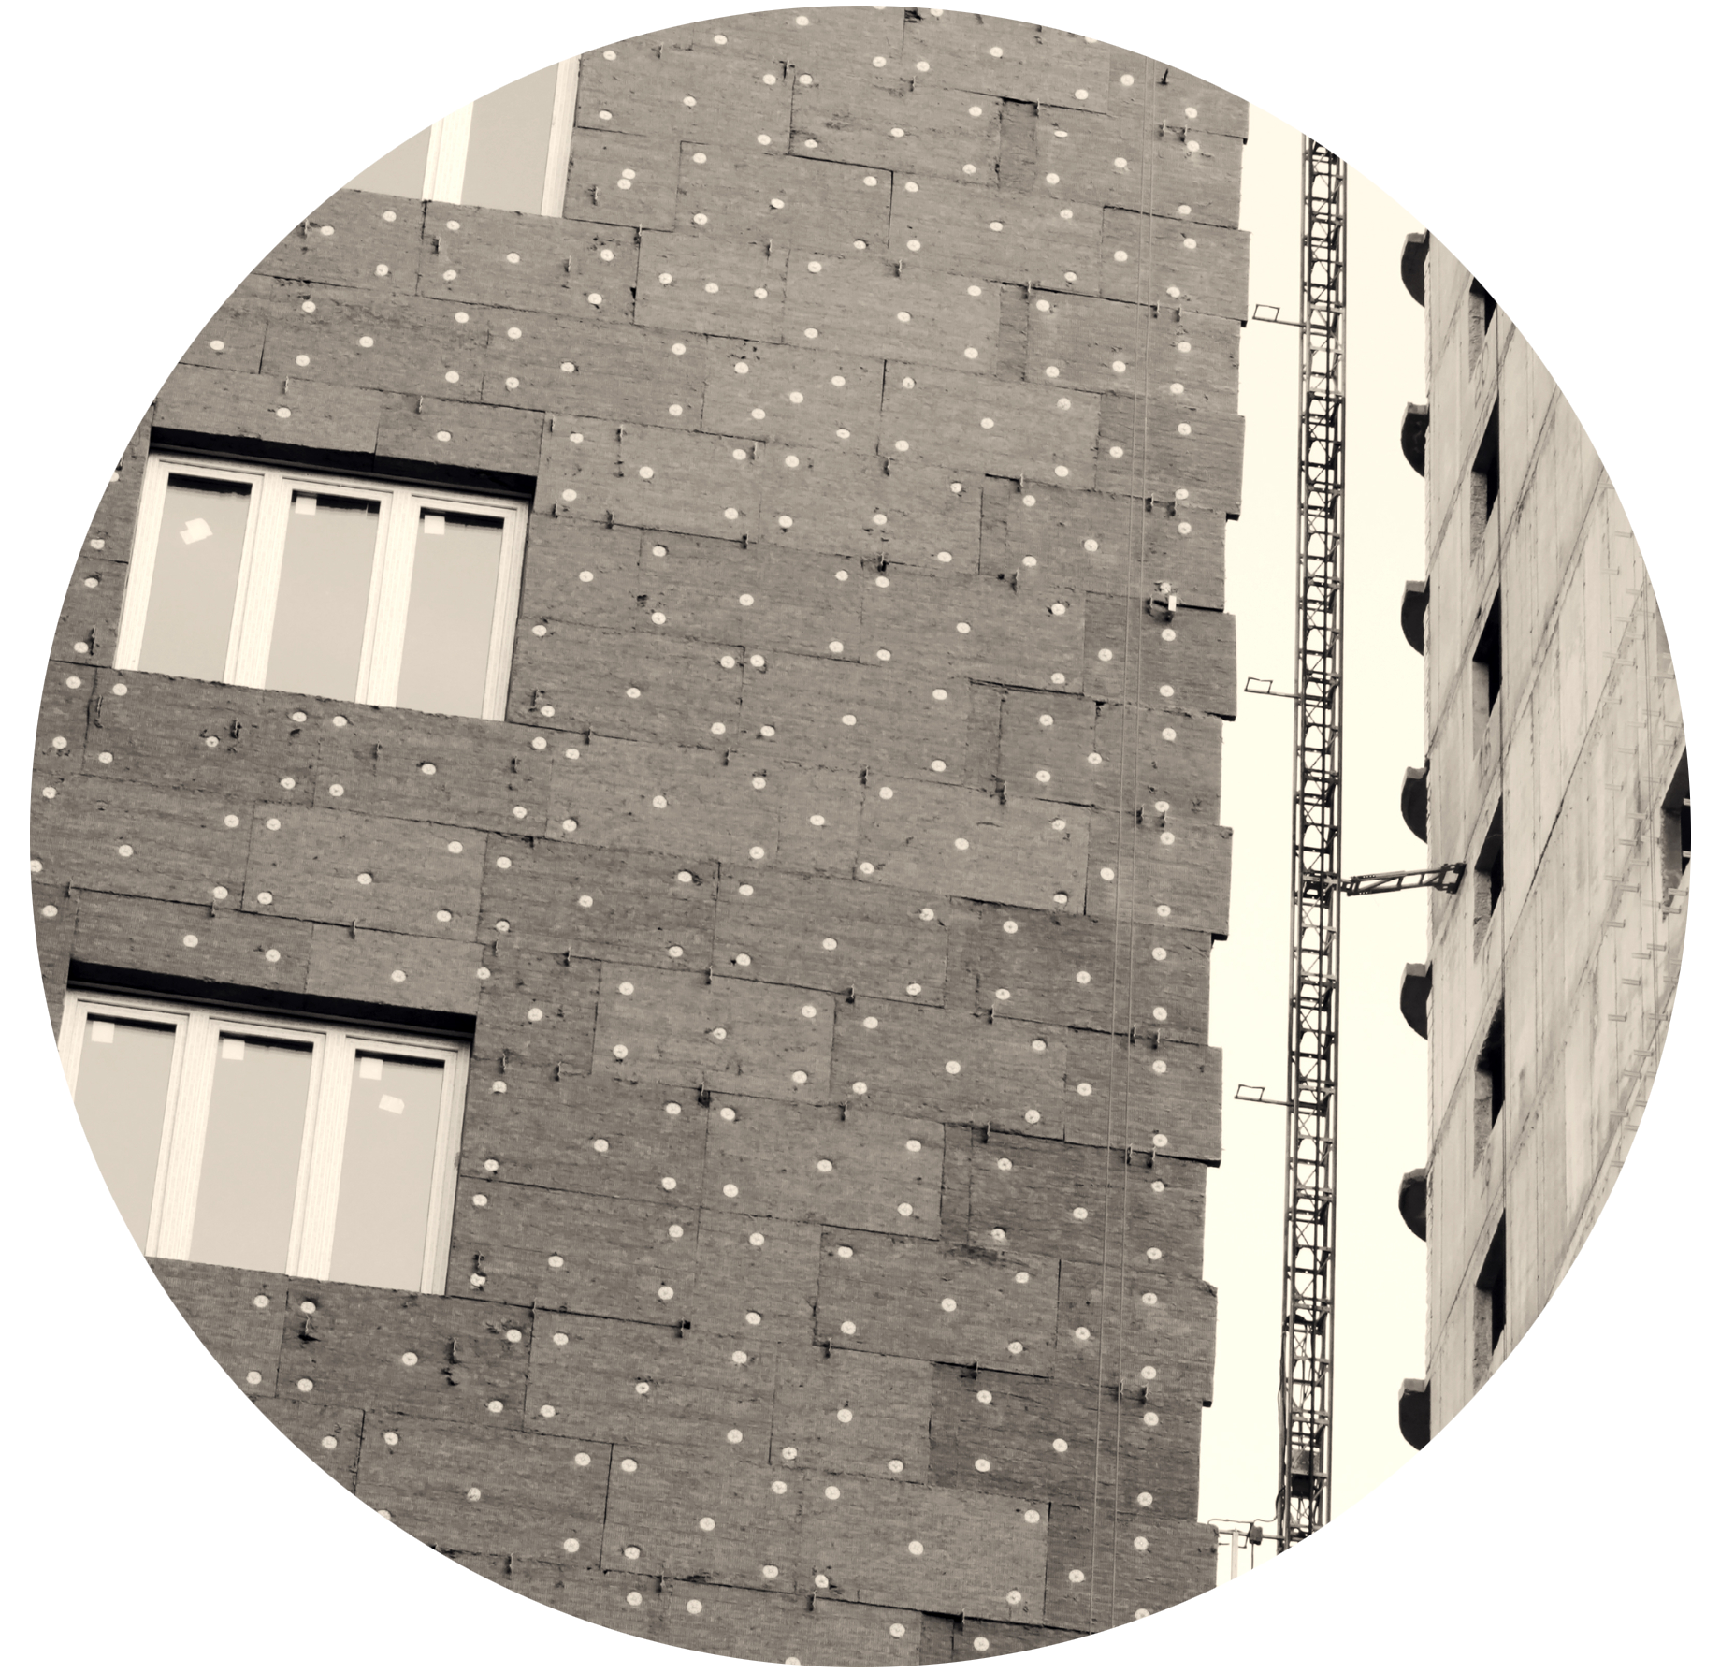
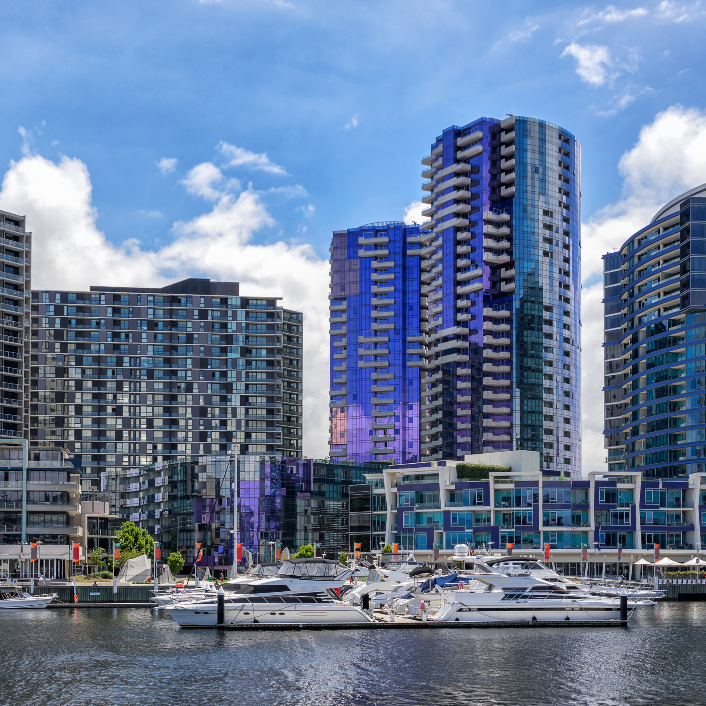
Management
Asbestos
Assessment/identification
Engagement of experts (e.g. Hygienist)
Treatment
  Encapsulation
  Removal
Replacement/Repair

Slide 4
Overview
MOULD
What is Mould?
When Will Mould Occur?
What are the risks of Mould?
Mould can be found almost anywhere; it can grow on virtually any organic substance, as long as moisture and oxygen are present.
Water ingress
Environmental
(e.g. ventilation)
Health Risks
Building damage

Slide 5
Mitigation Process
MOULD
Prevention is number one
  Fix leaking plumbing and leaks in the building envelope ASAP
  Watch for condensation and wet spots
  Keep humidity to a minimum
  Keep ventilation systems clean and maintained
  Don’t let foundations stay wet for extended periods
Remediation
    Fix water humidity problems
    Engage experts to assist in identification
    Localise/contain contaminated areas
    Deploy appropriate remediation techniques

Slide 6
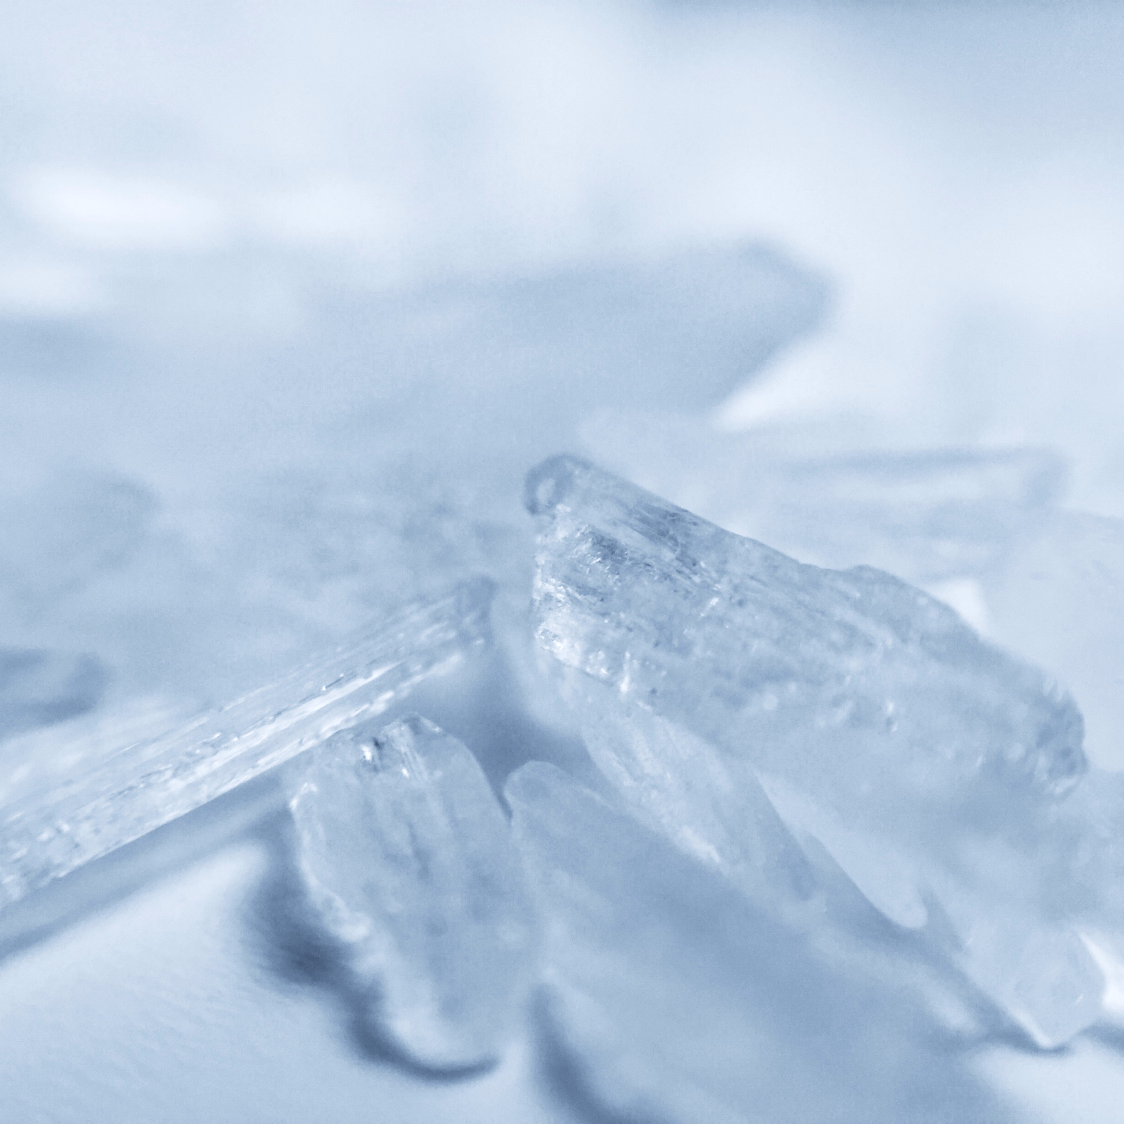
Overview
METH
What is Meth?
It’s a highly addictive drug.
It has numerous street names: known as Meth, Ice or “P”.
Meth is usually smoked but can also be dissolved in liquid and injected or snorted.
It’s easy to manufacture and can be made from common household items

Slide 7
Precursor drugs/chemicals
METH
Meth is easily made by combining the below chemicals and heavy metals into a 2-litre drink bottle! This type of manufacturing is referred to as the “shake n bake” method.
Pseudoephedrine – contained in over-the-counter cold medicines.
Ephedrine – a natural medication and stimulant which is extracted from a plant source
Lithium – found in batteries.
Red phosphorus – found in matches and road flares.
Aluminum / Zine / Lead / Iodine – used as a catalyst to produce a chemical reaction.
Ammonium Nitrate / Ether / Sodium Hydroxide - mixed with precursor drugs and metals to produce a chemical reaction.

Slide 8
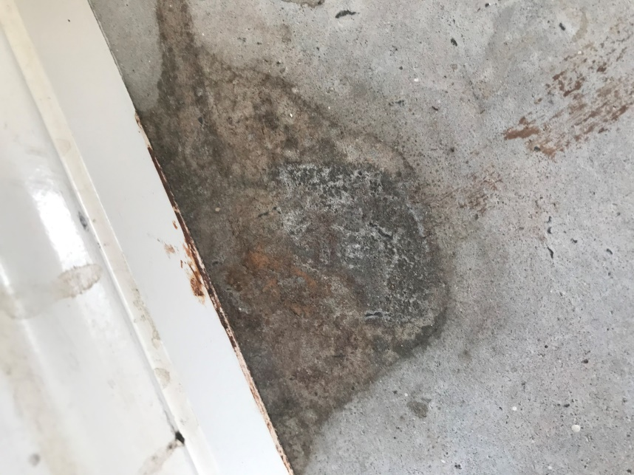
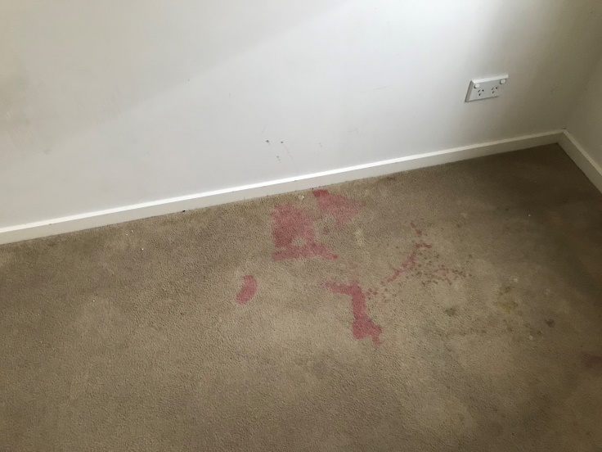
Where will we find it?
METH
Reality is, we should expect to find it in every landlord claim we inspect.
Rented properties (Landlord claims)
Strata properties
Residential Properties
AirBNB properties
Community housing
Government housing

Slide 9
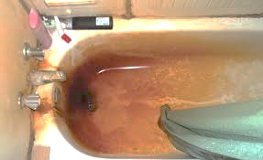
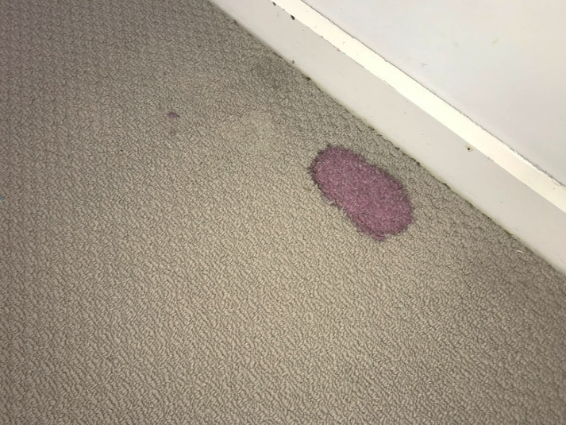
What are the Signs?
METH
We are often notified by the insurer prior to attending the site (often identified or suspected by the property manager)
Manufacturer
User
Known as “cooking”
Altered smoke detectors,
malicious damage
Red staining to baths, carpets, utensils – from a particular process
Painted walls in an attempt to cover spills and splashes
More difficult to detect
Syringes/needles
Pipes (smoking utensils)

Slide 10
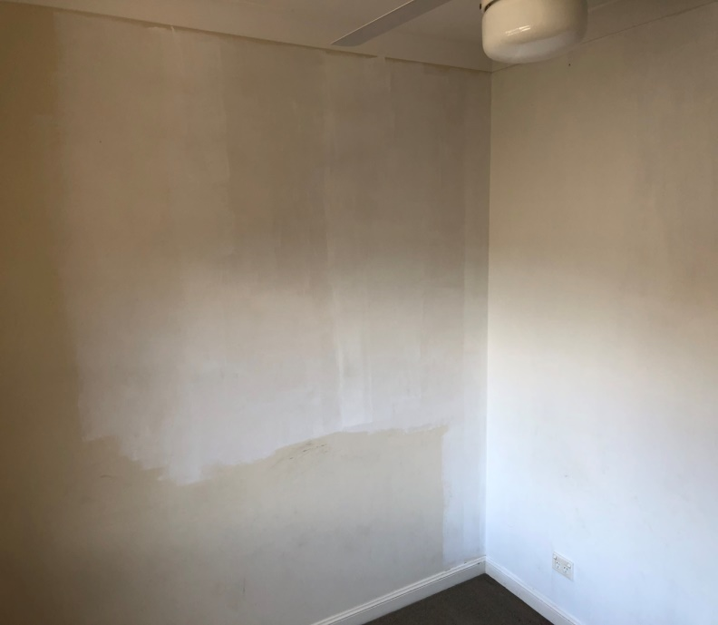
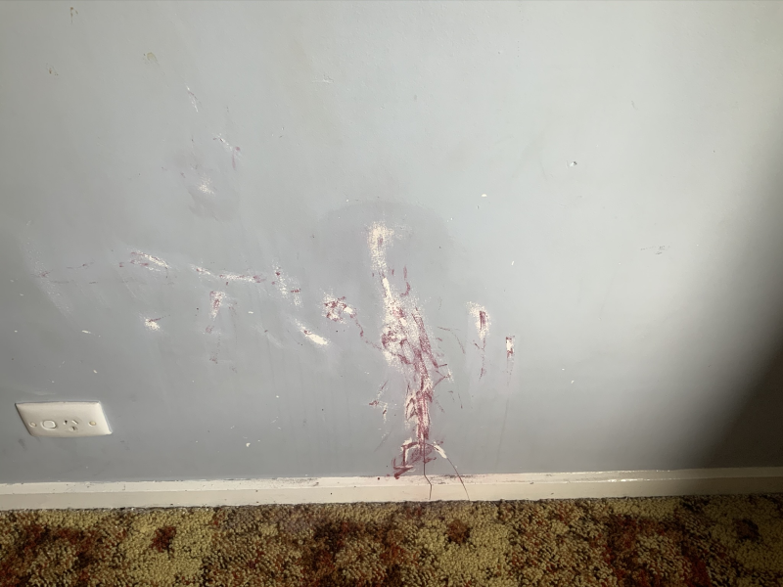
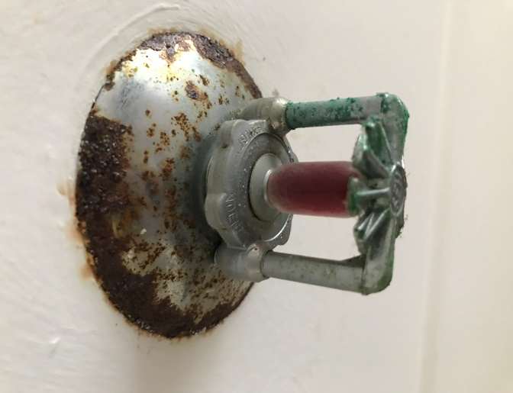
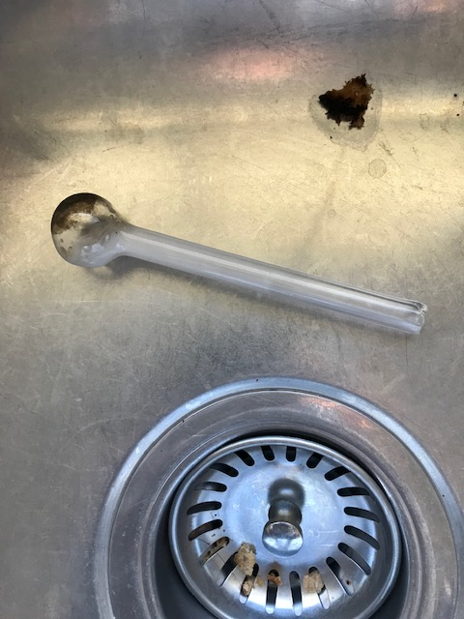
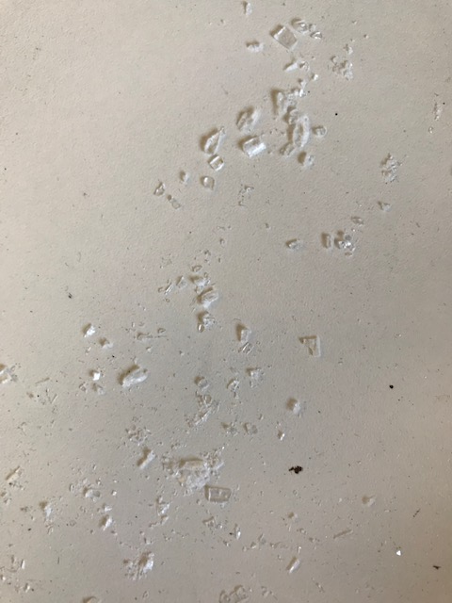
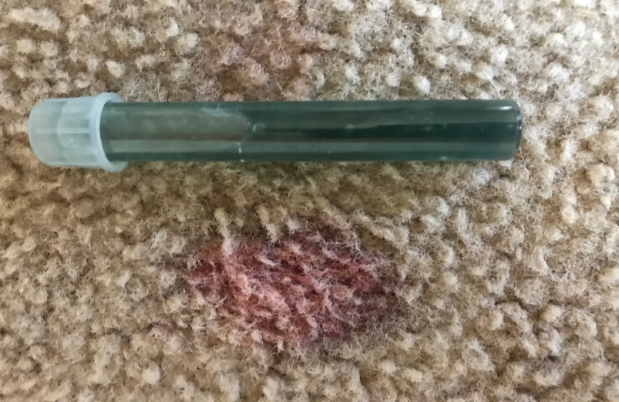
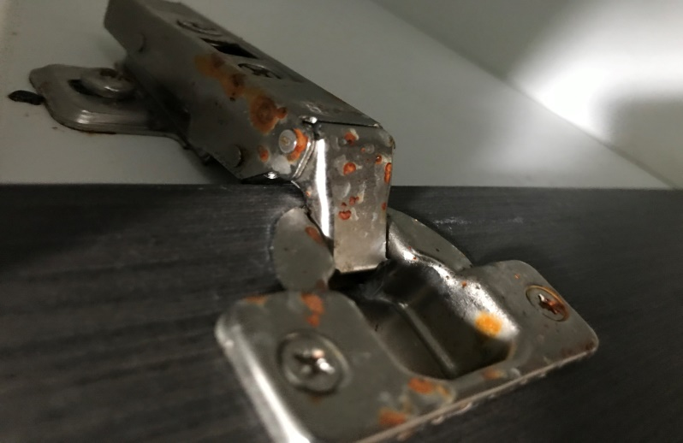
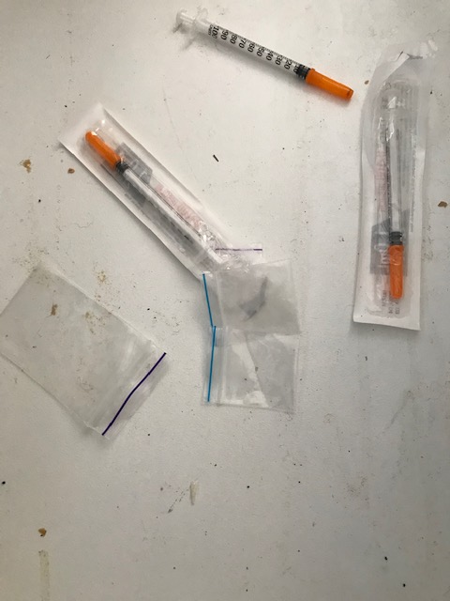
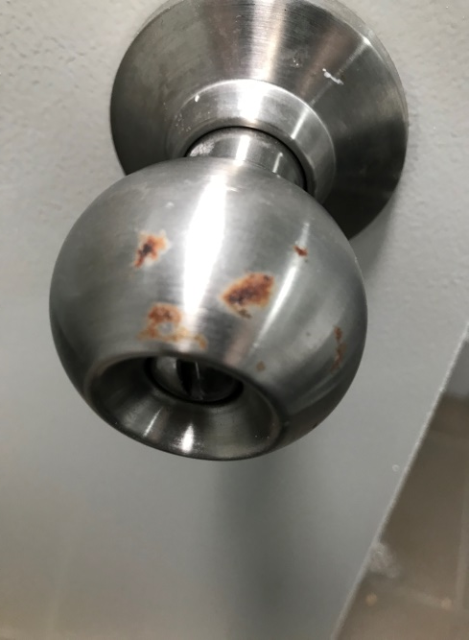
METH
Indicators
Evidence of “rough” living and rubbish around the premises, especially red carpet stains
Covering and blacking out of windows (or evidence of)
Strong odours of acetone, ammonia or other chemical smells.
Sour smell of cat urine.
Pill packaging.
Stains on walls or evidence of recent attempts at cleaning or painting
Burns, powder residues, crystalline residue on benches.
Corrosion to metal surfaces such as cabinet hinges, towel racks & door knobs.
Red/Orange staining in drains, sinks and toilets.
caring counts
10

Slide 11

What are the dangers?
METH
Using meth is not good for your health
Meth contamination is unlike other drug contamination such as cannabis or cigarette smoke as the contamination remains in the building long after the manufacturers or users have moved out, even if there have been renovations.
Meth is chemical based and isn’t biodegradable, so it doesn’t disappear, and contamination can remain in the building for years after it was used.
Testing has shown that simply painting over a contaminated plasterboard does not eliminate the contamination and it may eventually leach through the paint in due course.
Before
meth
2.5 years
of meth

Slide 12
Testing
METH
Why is this important and what is involved? To ensure consistency, we follow the
Australian Government Clandestine Drug Laboratory Remediation Guidelines (2011)
Rapid Testing (presumptive) should be used to confirm the presence of methamphetamine within the property
If a positive result is achieved, a hygienist or registered Indoor Environmental Professional (IEP) should be engaged
Samples are collected are collected and sent to a NATA accredited laboratory for analysis
Additional ghost wipe samples are collected and tested for heavy metals used in the manufacturing process.
These include, Red Phosphorus, Iodine, Lithium, Aluminium and Zinc.
Based on the level of contamination, the hygienist will prepare a Remediation Action Plan (RAP)
A remediation company is required to carry out any decontamination as per the hygienist’s recommendations
The hygienist reattends for final testing and clearance – a clearance certificate is issued upon successful remediation

Slide 13
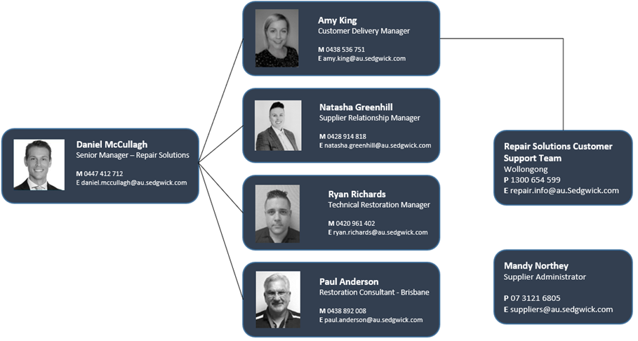
Meet the Team
Repair Solutions
Andrew Walsh
VIC/TAS
Paul Hastings
SA/NT
Notes:
Ed

Slide 14
Thank you

